Slide 1
Mechanica:Rocket science
Sam Motmans

Slide 2
Rocket height measurement
Principles & Methods
Electronic hardware & software
Data structure & example

Slide 3
Principles & Methods
Height measurement?
Accellerometer?
Gyroscope?
Altimeter?
Gyroscope + Accellerometer?
Altimeter + Accellerometer?

Slide 4

Accellerometer
Measures acceleration of object
Measurements at steady intervals
Possible to acquire velocity
In function of time

Slide 5

Gyroscope
Measures orientation of object
No measurements of displacement of object
In function of time

Slide 6
Accelerometer+ Gyroscope
Measures acceleration & orientation of object
Problems with this method?
If object starts rotating around it’s axis it introduces acceleration in all directions. → Height can not be estimated correctly

Slide 7
Altimeter + Accelerometer
Measures height and acceleration of object
Height in function of time
Acceleration in function of time
Velocity in function of height

Slide 8
Electronic hardware & software
Components
Espressif-ESP32 Microcontroller
MMA8451Q Accelerometer
MPL3115A2 Altimeter
Specs
Operating voltage: 2.6v – 3.6V
Weight : ~40g

Slide 9
Electronic hardware & software: Datasheets
Espressif-ESP32 Microcontroller
https://www.espressif.com/sites/default/files/documentation/esp32-wroom-32e_esp32-wroom-32ue_datasheet_en.pdf
MMA8451Q Accelerometer
https://www.nxp.com/docs/en/data-sheet/MMA8451Q.pdf
MPL3115A2 Altimeter
https://www.nxp.com/docs/en/data-sheet/MPL3115A2.pdf

Slide 10
Electronic hardware & software: Schematic

Slide 11
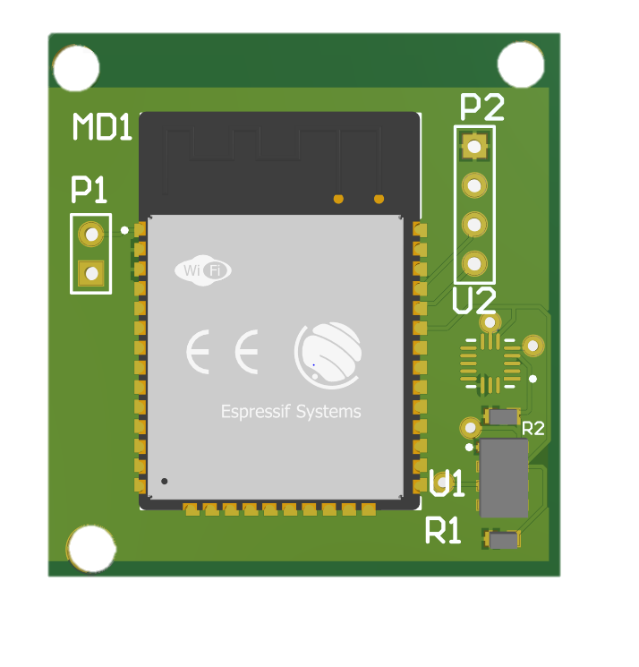
Electronic hardware & software: PCB

Slide 12
Electronic hardware & software
Language driver C++
Language dashboard/ parser: Python
See attachment

Slide 13
Data structure & example
Data structure: .CSV FORMAT
Comma separated value
Height , accel_x, accel_y, accel_z

Slide 14
Rocket Science
Place the circuit board as seen fit in your design
Read out the data and visualize to see the height trajectory of the rocket
Utilize acceleration and height data to get x, y, and z directions of the trajectory.
Visualize this data

Slide 15
Mechanica:Rocket science
Sam Motmans

